Slide 1





5G Technology and National Security: Vulnerabilities and Best Practices
ORebeca

Slide 2
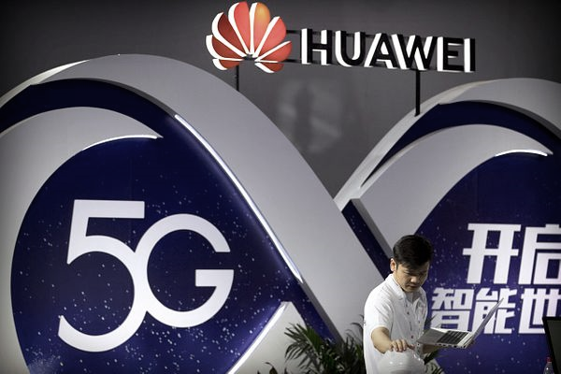
Huawei, 5G And Security

Slide 3
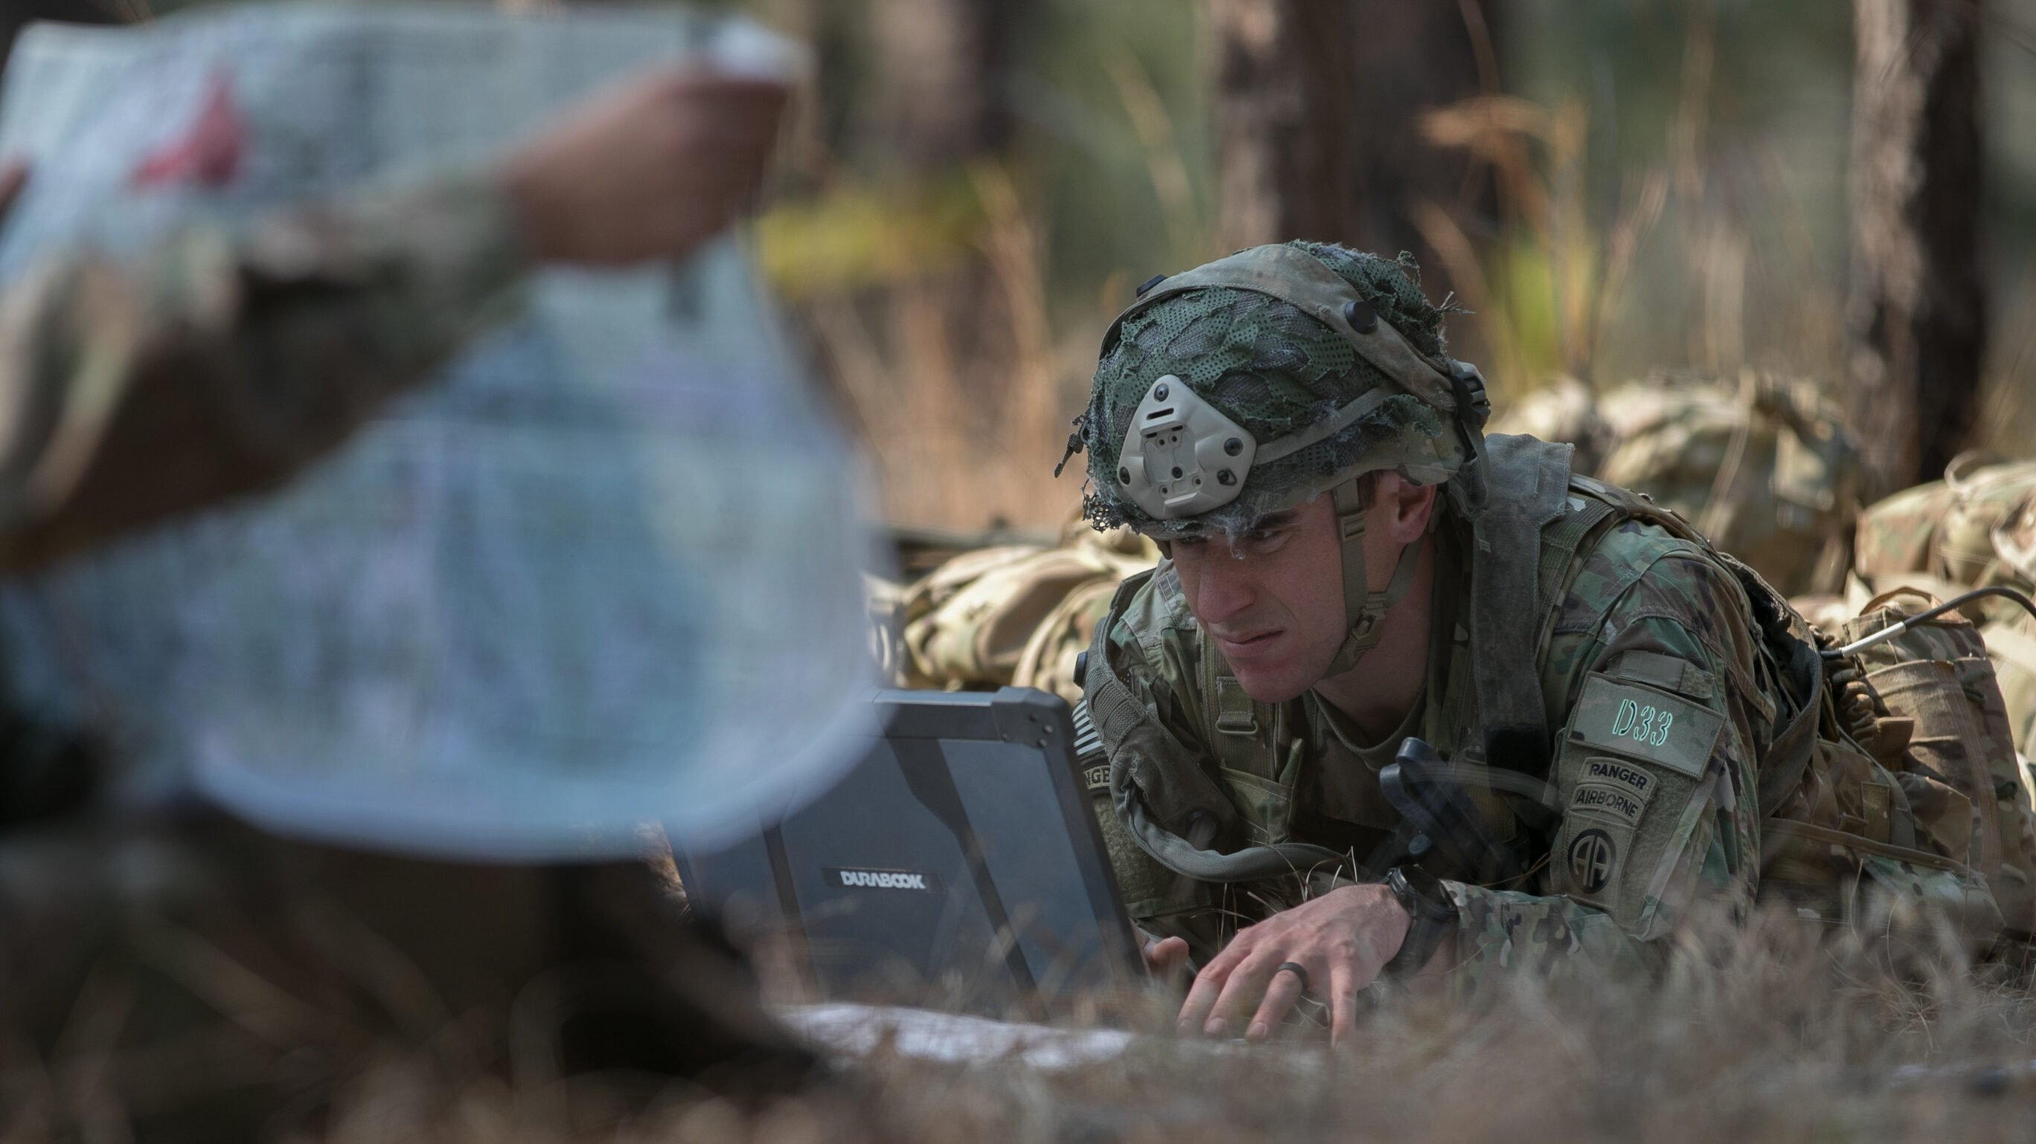

Slide 4
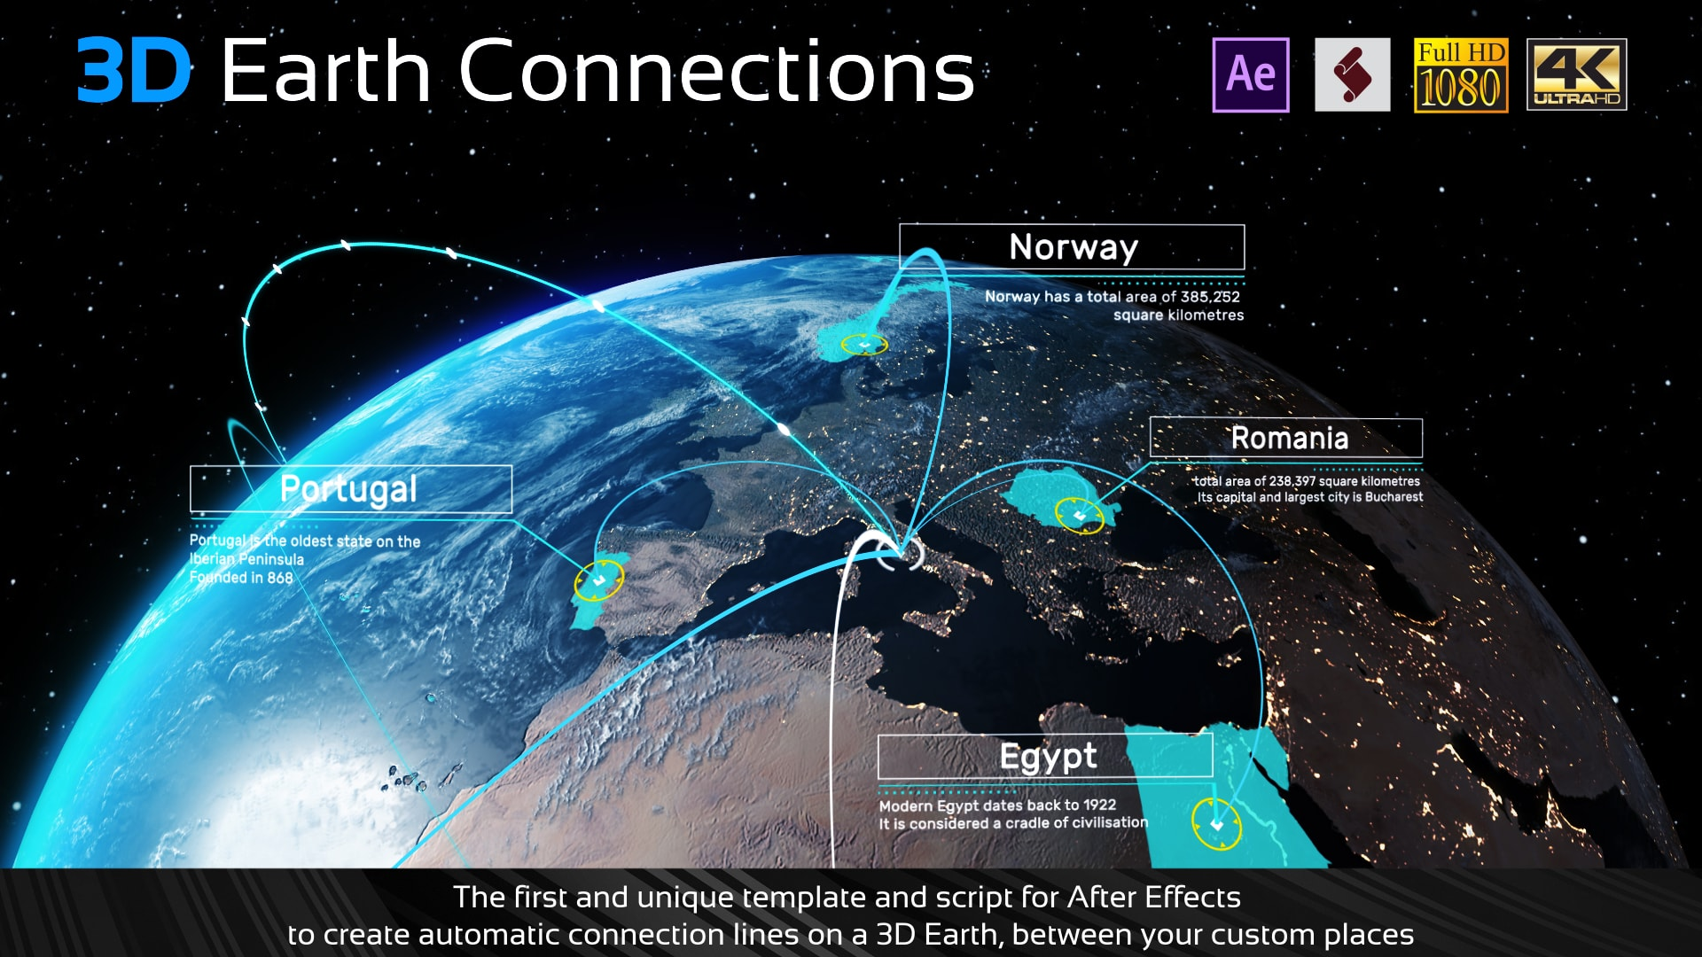

Slide 5


Slide 6
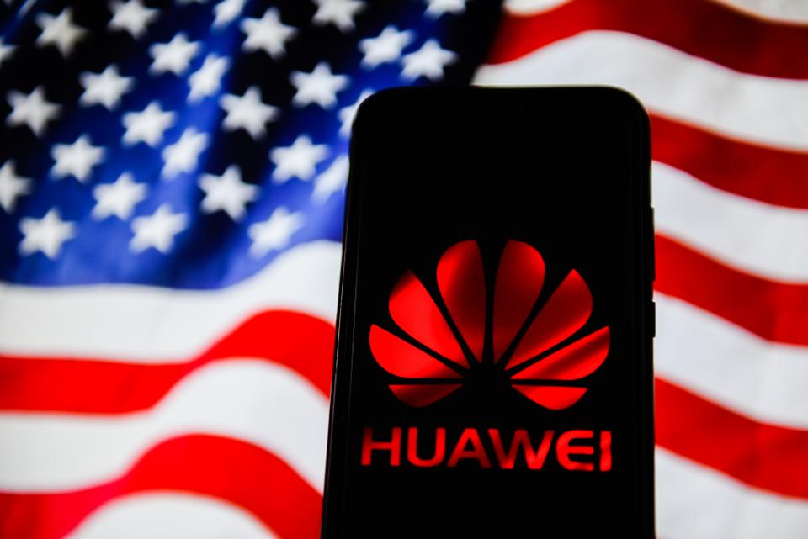

Slide 7
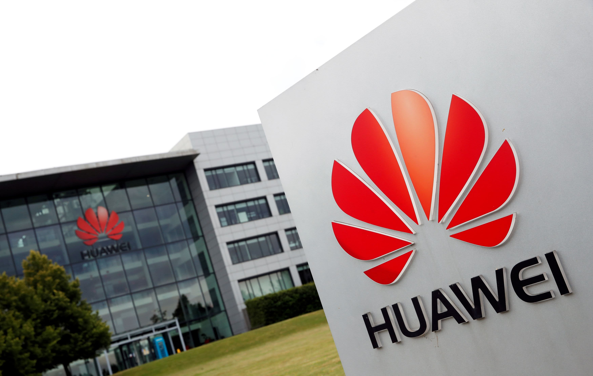

Slide 8


Slide 9


Slide 10
What small countries can teach great powers?

Slide 11
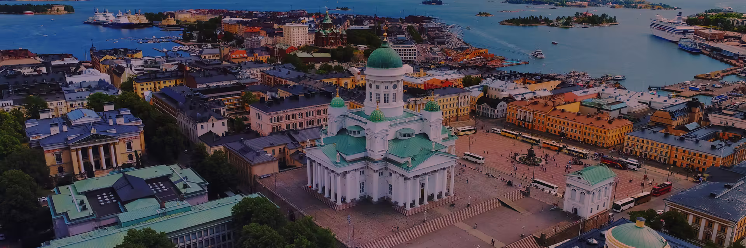

Slide 12
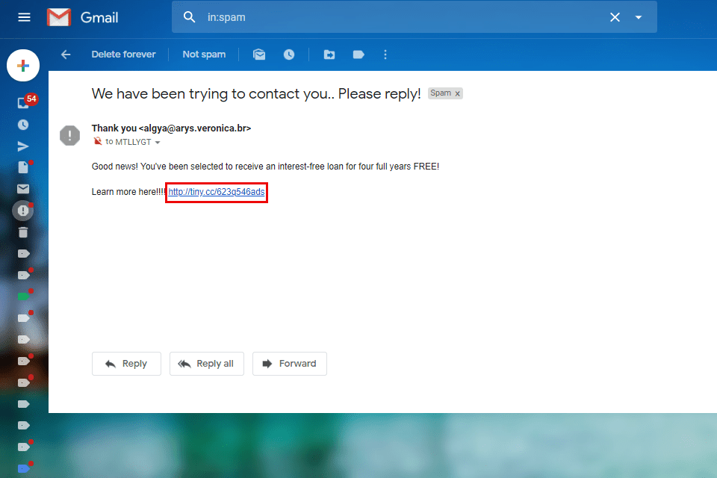

Slide 13
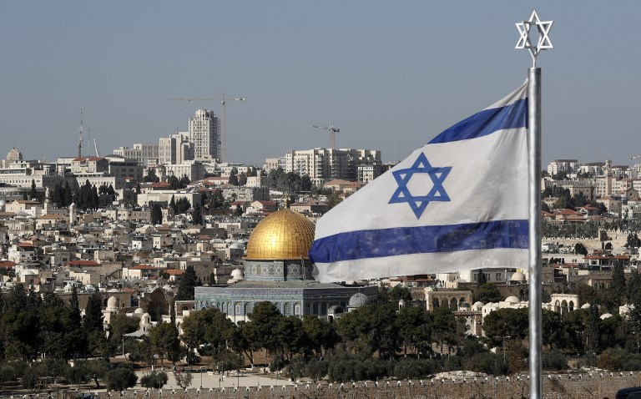

Slide 14


Thanks!

Slide 15
Credits
Presentation template by SlidesCarnival
https://www.c4isrnet.com/battlefield-tech/it-networks/5g/2021/05/10/national-security-agencies-warn-of-5g-network-vulnerabilities-adversary-influence/
https://media.defense.gov/2021/Oct/28/2002881720/-1/-1/0/SECURITY_GUIDANCE_FOR_5G_CLOUD_INFRASTRUCTURES_PART_I_20211028.PDF
https://www.cbc.ca/news/science/huawei-5g-security-testing-vulnerabilities-risks-proof-ban-1.4997957
https://www.ncbi.nlm.nih.gov/pmc/articles/PMC8200965/

